Slide 1
CS491/691: Introduction to Aerial Robotics
Human Detection Through IR Vision
Anurag Kulkarni, Marcus Casey
Team Infrared

Slide 2
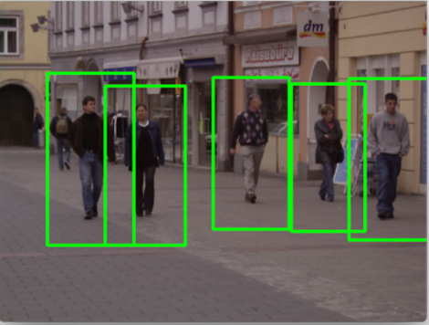

Motivation and Problem Description
Human detection through Infrared Vision can be utilized for various realistic real-world applications ranging from search and rescue, image/video processing to identify humans, and many more.
Without infrared, current deep learning algorithms allow for human detection with a lower accuracy if the trained dataset varies from the actual dataset through visible camera frames.
Use an image to explain the motivation and the challenges
Fig 1: Human detection through stereo cameras could cause various errors (Rosebrock, 2015)
CS491/691 Introduction to Aerial Robotics, TEAM INFRARED, Instructor: Dr. Kostas Alexis

Slide 3
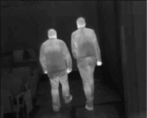
Motivation and Problem Description
Using thermal vision through infrared vision, humans can be detected based on their thermal heat emittance. This way, the presence of humans can be detected regardless of their pre-trained posture datasets, hence reducing the room for errors.
Main objective is to develop an efficient computer vision algorithm that can enable human detection from lightweight low-resolution IR cameras.
Use an image to explain the motivation and the challenges
Fig 2: Human detection through IR vision (Elsevier Robotics and Autonomous Robots Journal, 2010)
CS491/691 Introduction to Aerial Robotics, TEAM INFRARED, Instructor: Dr. Kostas Alexis

Slide 4
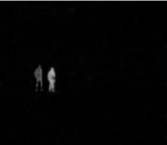
Proposed Approach
Using Python, humans can be detected through OpenCV library with the in-built HOG and SVM models in images and video streams.
Basic python libraries
Linear SVM (Support Vector Machine) models trained on HOG (Histogram of Oriented Gradient) features perform efficiently in detecting human presence through IR.
getDefaultPeopleDetector() SVM
INRIA Dataset
Try to overview the solution in the form of a block diagram or algorithm flow
Fig 3: Humans detected through IR regardless illumination. (Elsevier Robotics and Autonomous Systems Journal, 2015)
CS491/691 Introduction to Aerial Robotics, TEAM INFRARED, Instructor: Dr. Kostas Alexis

Slide 5

Open CV
Installed using Homebrew Environment
Open Computer Vision Library - Python
Can support C++, Java, etc.
Available on all platforms
Designed to solve computer vision problems
Uses Numpy, an optimized library for numerical operations with MATLAB-Syntax.

Slide 6
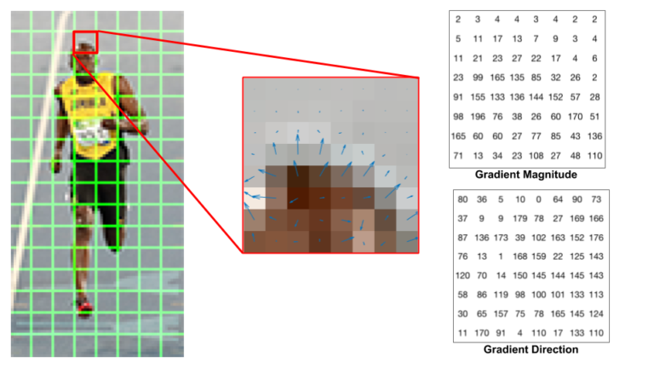
HOG
Histogram of Oriented Gradients
Uses feature descriptor-- image or image patch that simplifies image by only taking useful information.
Calculates HOG through 5 steps:
Processing
Calculating Gradient Images
Calculate in 8x8 cells
16x16 normalization
Calculate HOG feature Vector

Slide 7
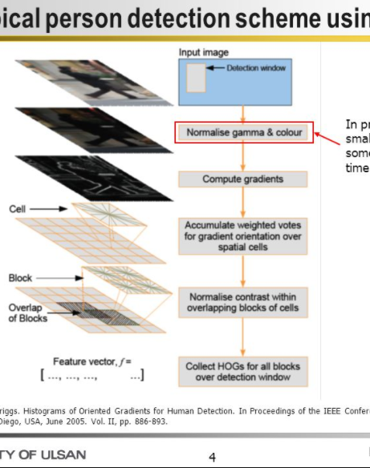
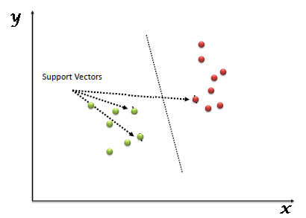
SVM
Support Vector Machine
Discriminative classifier defined by separating hyperplane
Outputting optimal hyperplanes which categorize new examples.
SVM Algorithm:

Slide 8
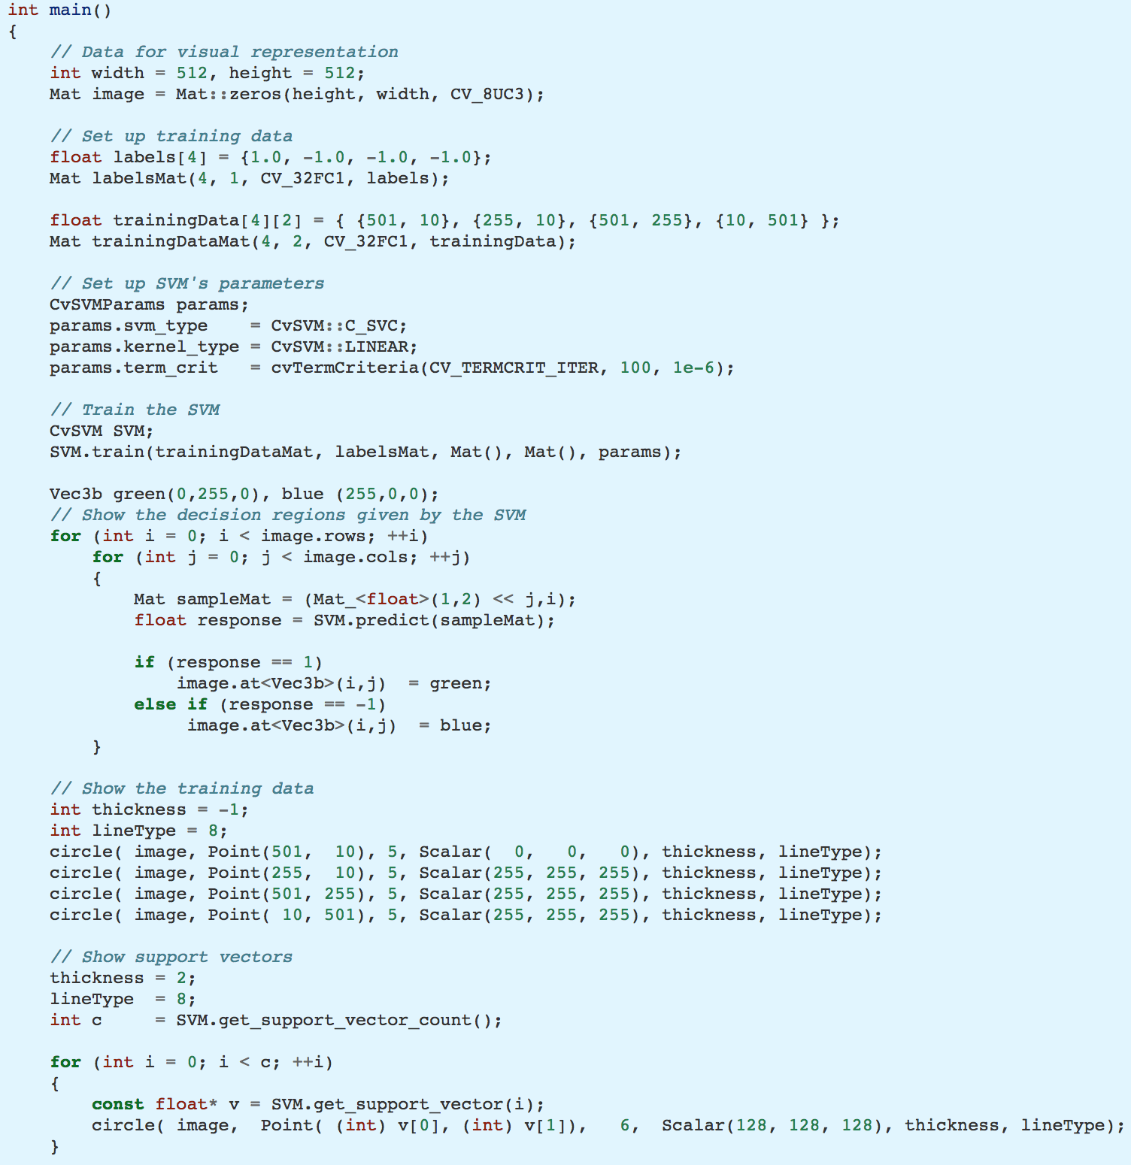

Slide 9

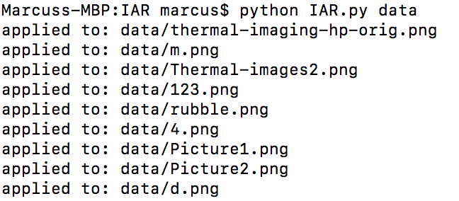
System Description
Terminal: MacOS terminal with python and anaconda was used to run the program.
Anaconda3 Distribution Navigator: Free and open source distribution of Python for large-scale data processing, predictive analytics, and scientific computing.
Hardware photo
or
Screenshot from software
CS491/691 Introduction to Aerial Robotics, TEAM INFRARED, Instructor: Dr. Kostas Alexis

Slide 10
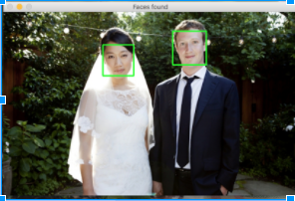
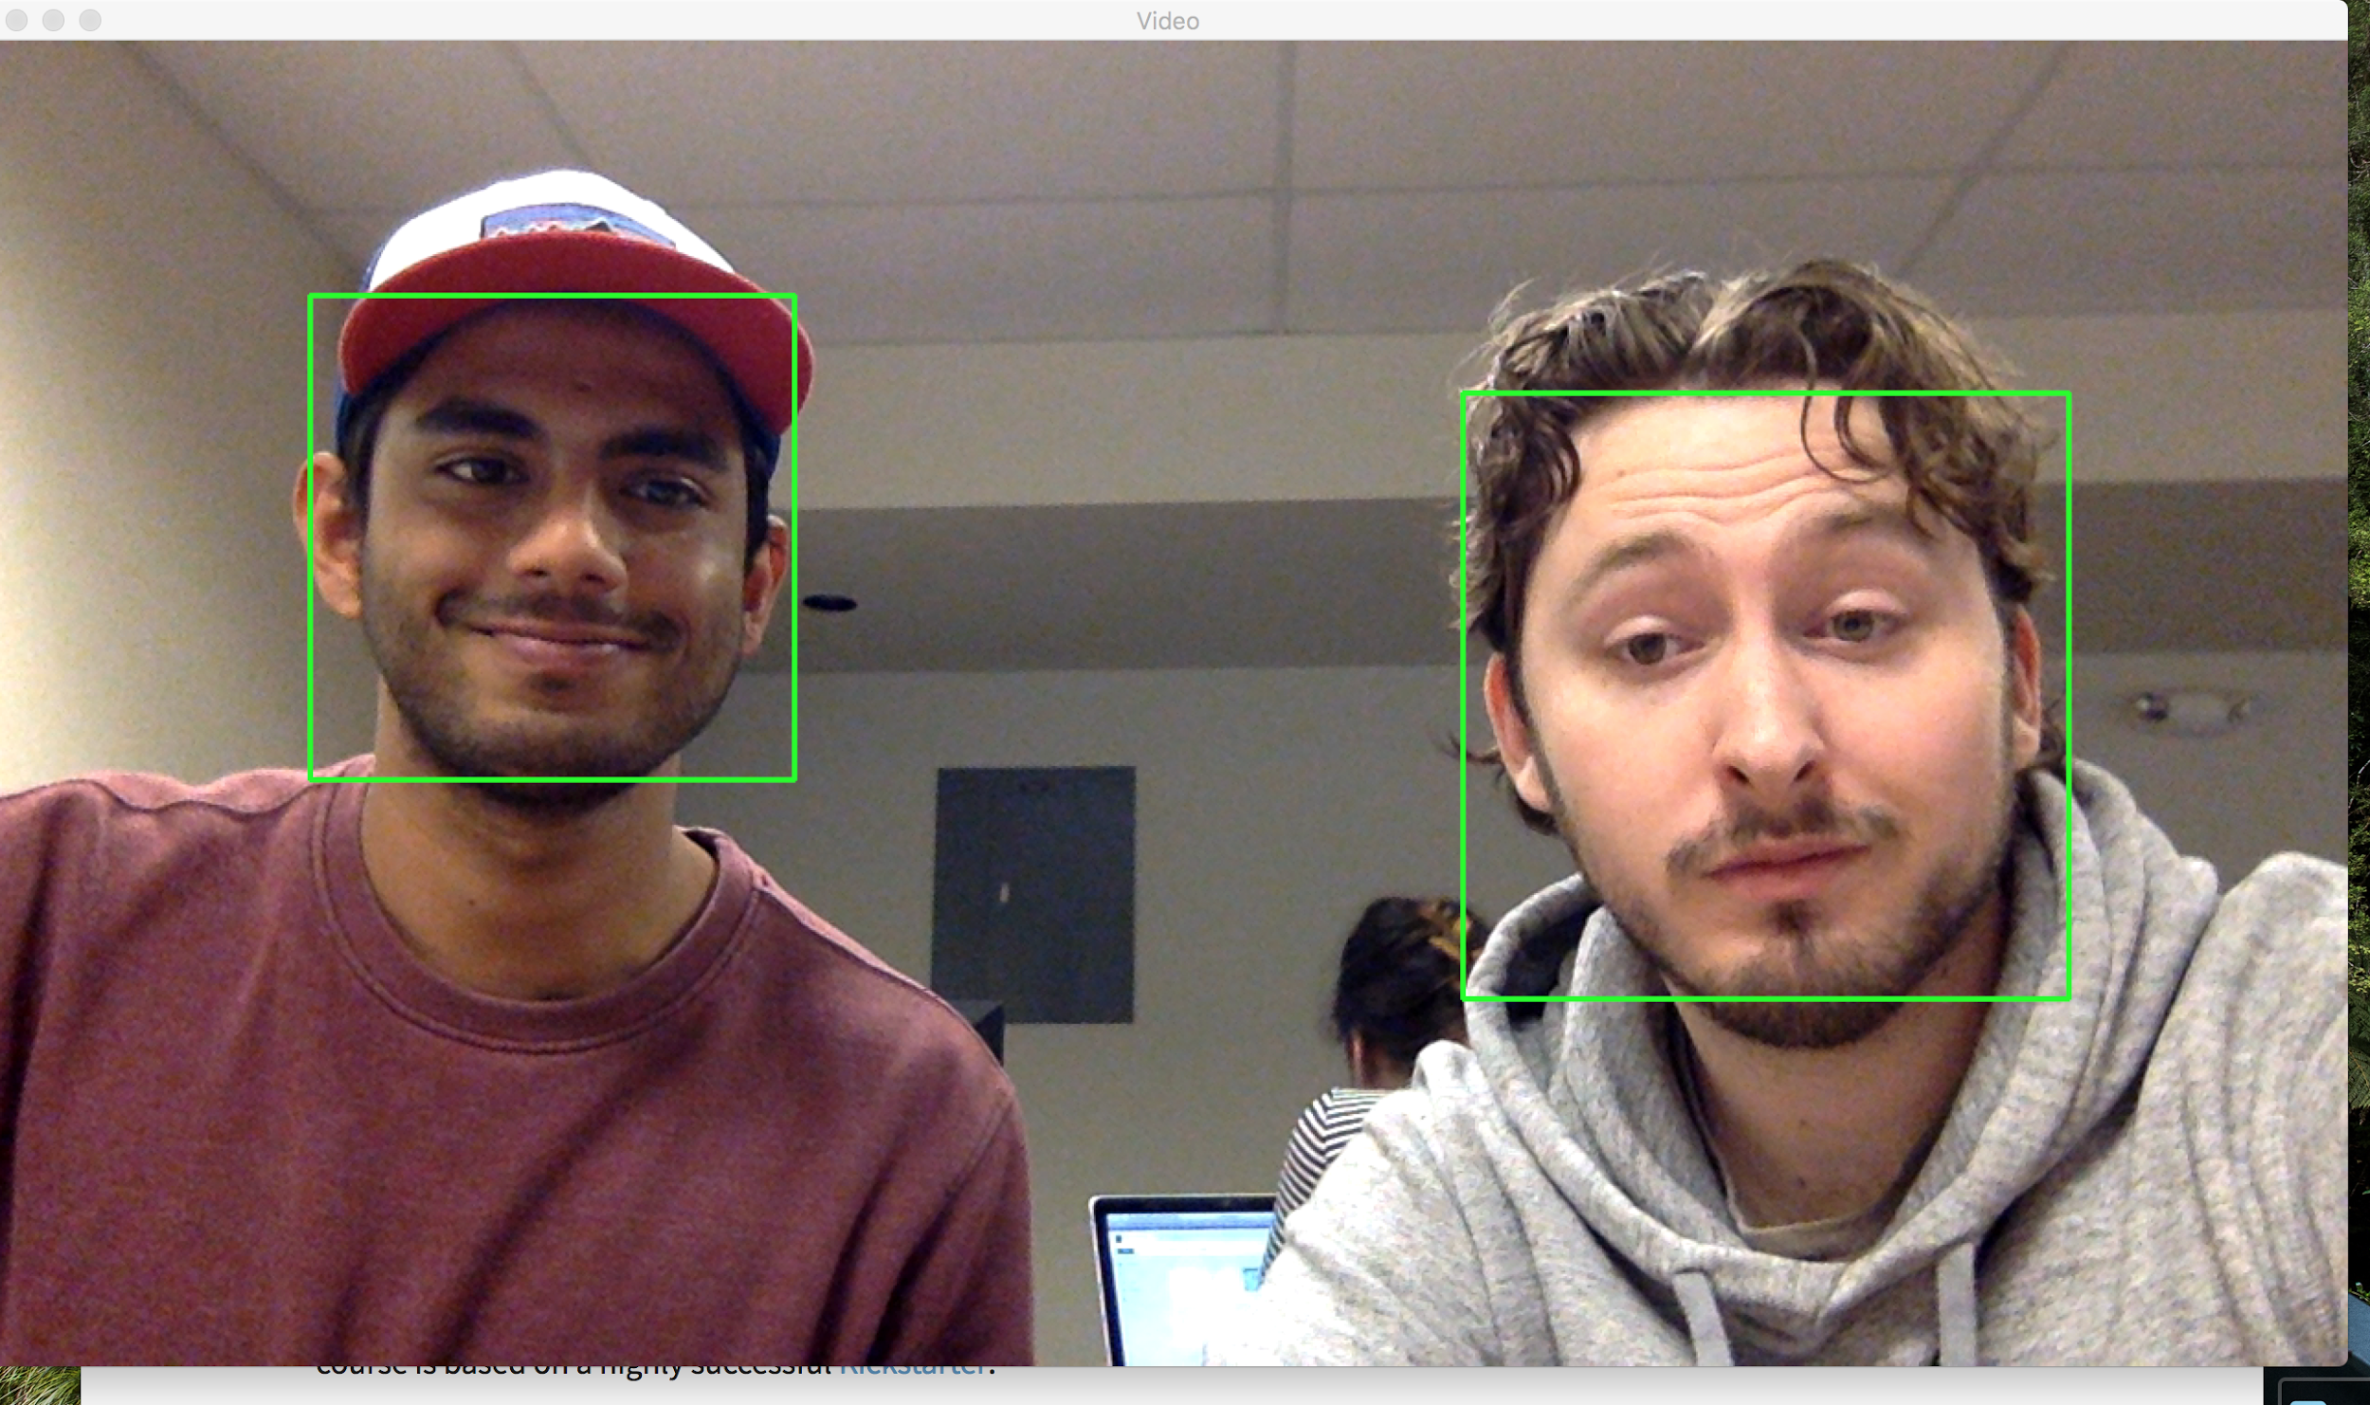

Initial Results
So far we have successfully utilized HAAR cascades to detect a human face in an image or a webcam feed.
Tested out with various images as well as Webcam footage and successfully detected faces.
Show a couple of results in the form of plots, video etc
CS491/691 Introduction to Aerial Robotics, TEAM INFRARED, Instructor: Dr. Kostas Alexis

Slide 11
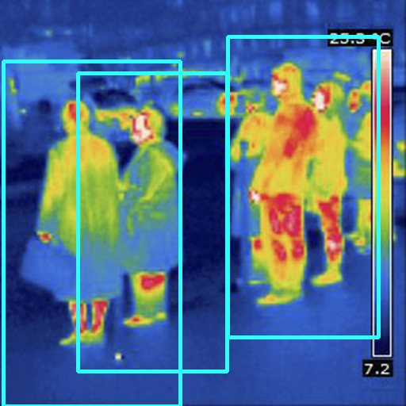
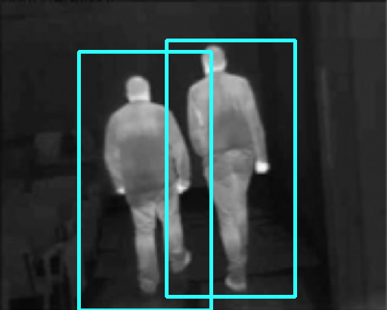
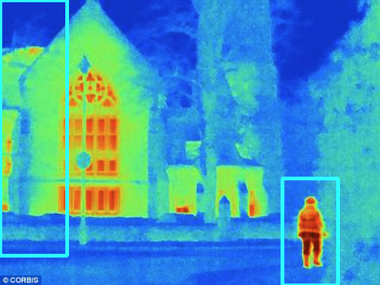
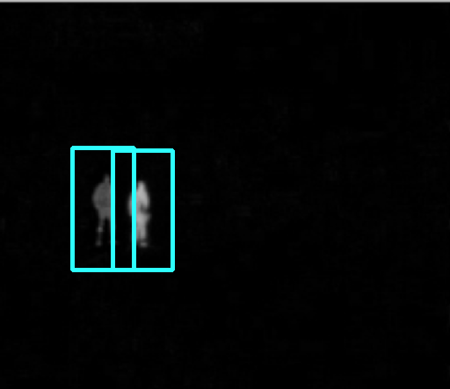
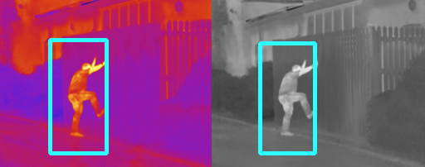
Final Results
Successfully implemented human detection on humans in IR & photocolor images.
Some problems do exist
Sizing
Features can be falsely flagged depending on image quality
Large amounts of people are difficult to identify
CS491/691 Introduction to Aerial Robotics, TEAM INFRARED, Instructor: Dr. Kostas Alexis

Slide 12
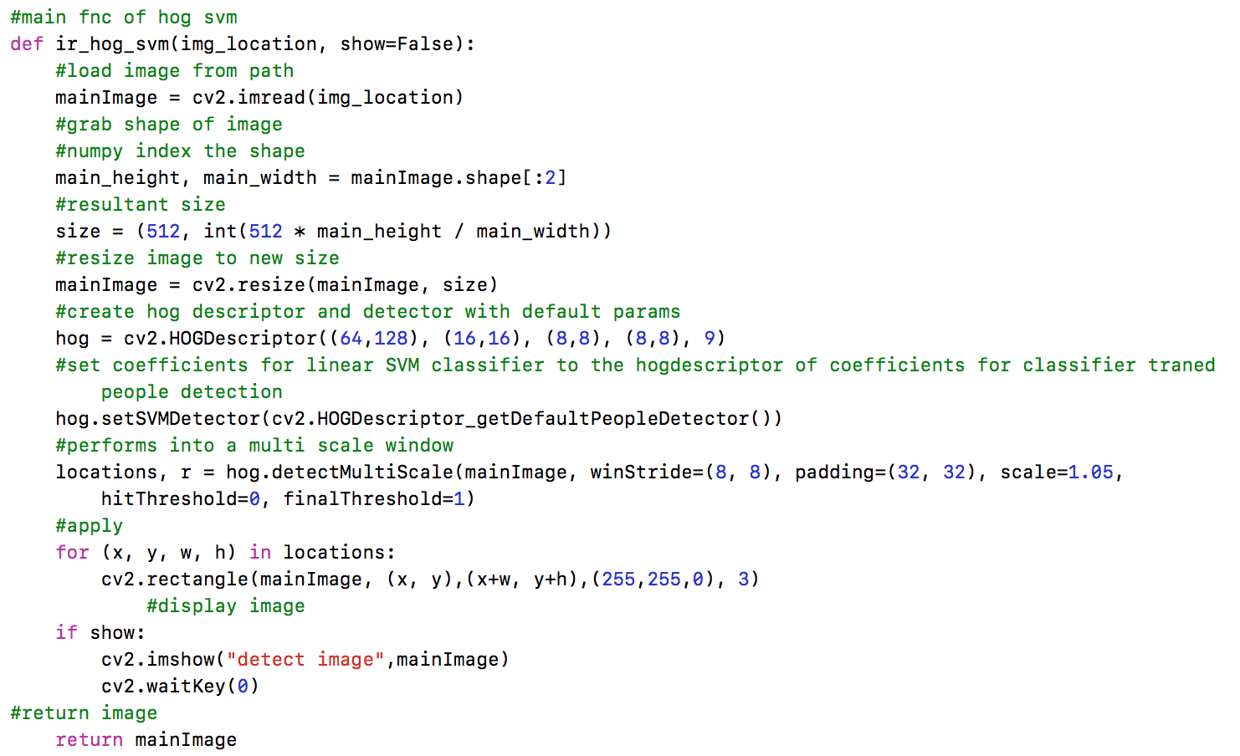
HOG SVM Implementation

Slide 13
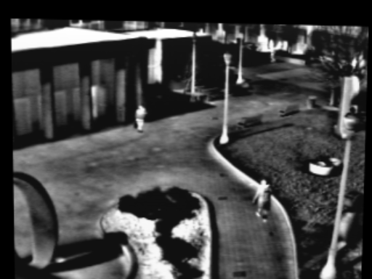
What Could We Do Better?
Contour Saliency Map + Multi Resolution Screening & Adaptive Filters
Probably the most ideal way of performing this project
Knowledge and time
Training
Properly done to ensure accurate pattern detection of humans
Time and logistic restraints based on implementation
We did implement a type of training through large amounts of images with trial and error
Mathematical Skills & knowhow
Implement Extensions to OpenCV such as LatentSVM
Would have allowed for higher performance and detection
Struggled to make it work
Allowed for detection in trickier images
getDefaultPeopleDetector() only trained on standing pictures
haar cascade paired with dpm module
CS491/691 Introduction to Aerial Robotics, TEAM INFRARED, Instructor: Dr. Kostas Alexis
Notes:
A Contour Saliency Map (CSM) [1] of a thermal image represents the confidence/belief of each pixel belonging to an edge contour of a foreground object (person)
To perform screening, each new input image is transformed into an image pyramid from which a multi-level CSM is computed.

Slide 14
References
Fernández-Caballero, Antonio, et al. “Optical Flow or Image Subtraction in Human Detection from infrared Camera on Mobile Robot.” Elsevier Robotics and Autonomous Systems Journal, 26 June 2010, ruidera.uclm.es/xmlui/bitstream/handle/10578/2101/fi_1332170738-sdarticle.pdf?sequence=1.
Davis, James, Keck, Mark. “A two-stage template approach to person Detection in Thermal Imagery.” Ohio State University Computer Science department. Applications of Computer Vision, 2005.
Portmann, J, Lynen, S, Chli, M & Siegwart, R 2014, People Detection and Tracking from Aerial Thermal Views. in Proceedings of the IEEE International Conference on Robotics and Automation (ICRA). IEEE, pp. 1794 - 1800. DOI: 10.1109/ICRA.2014.6907094
Rosebrock, Adrian. “Pedestrian Detection OpenCV.” PyImageSearch, 9 Nov. 2015, www.pyimagesearch.com/2015/11/09/pedestrian-detection-opencv/.
Rosebrock, Adrian. “Pedestrian Detection OpenCV.” PyImageSearch, 10 Nov. 2015, www.pyimagesearch.com/2014/11/10/histogram-oriented-gradients-object-detection/
Dalal, Navneet, and Bill Triggs. “Histograms of Oriented Gradients for Human Detection.” Inrialpes. https://lear.inrialpes.fr/people/triggs/pubs/Dalal-cvpr05.pdf.
Wang, Tao, Cosman, Rafael. “Histograms of Oriented Gradients for Human Detection.” Stanford Vision. http://vision.stanford.edu/teaching/cs231b_spring1213/slides/hog_rafael_tao.pdf
CS491/691 Introduction to Aerial Robotics, TEAM INFRARED, Instructor: Dr. Kostas Alexis

